Slide 1
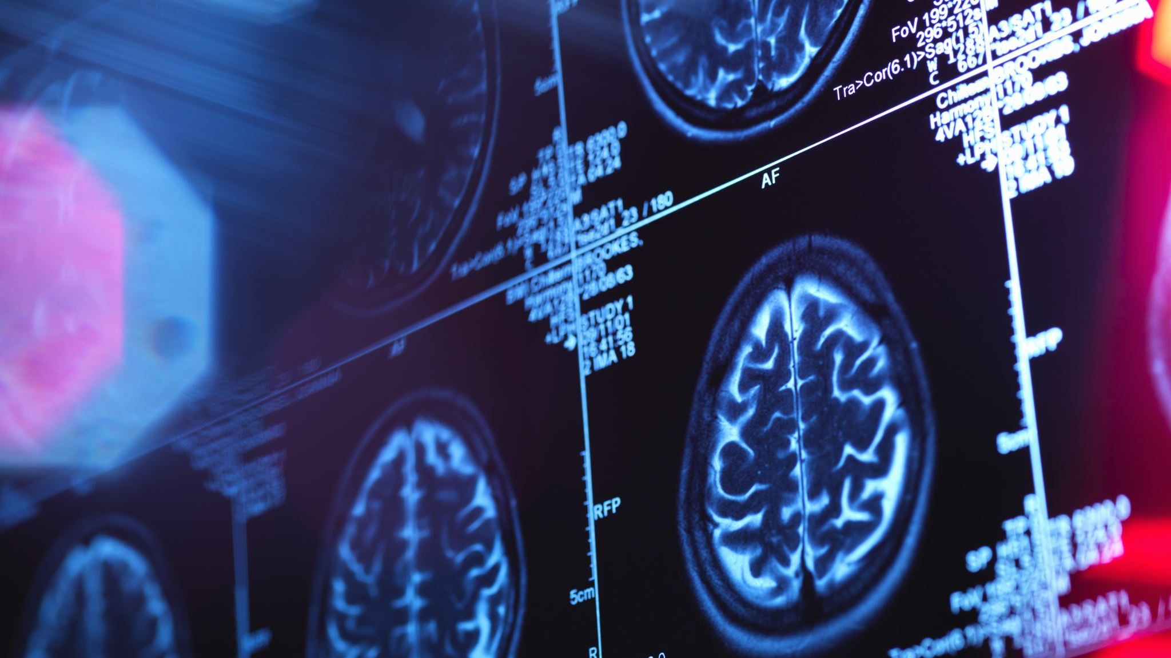
AI Trends in Healthcare

Slide 2
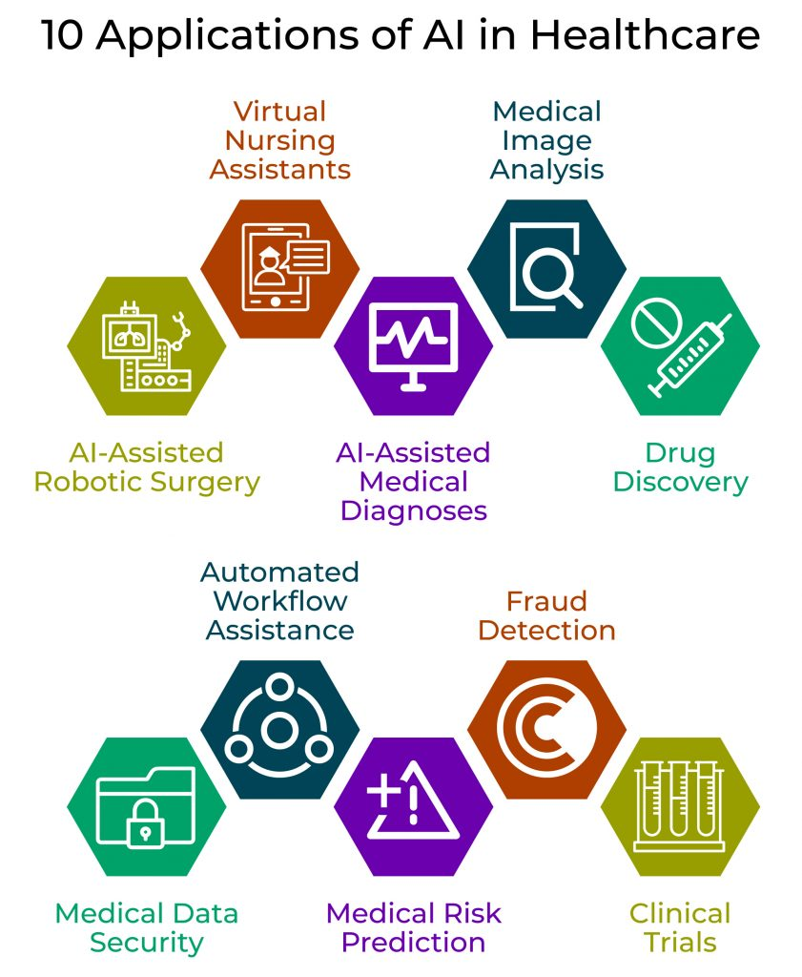

Slide 3
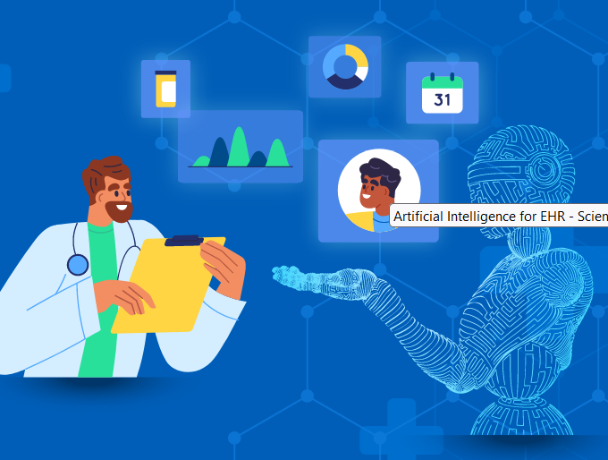
Electronic Health Records (EHRs)
Digital records of a patient’s
medical history
diagnoses
Immunizations
laboratory data
radiology reports.

Slide 4
Electronic Health Records
FHIR (Fast Healthcare Interoperability Resources) - Protocol
It uses a modern suite of APIs, allows to use JSON, XML or RDF for data representation
hospitals and private practices are being able to generate a huge amount of data.
NLP converts doctor hand written notes into structured data

Slide 5
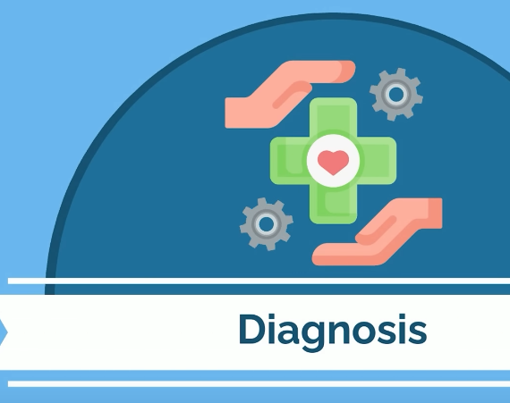
2. Diagnosis Prediction

Slide 6
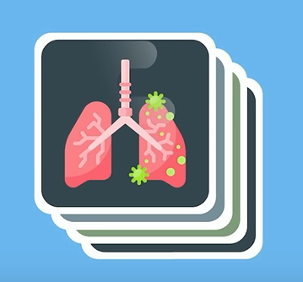
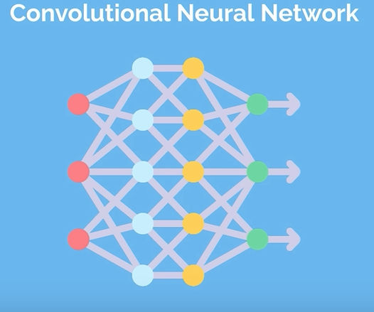

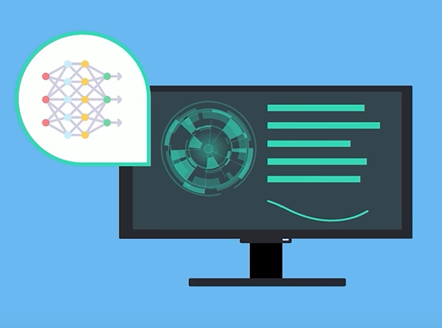

Slide 7
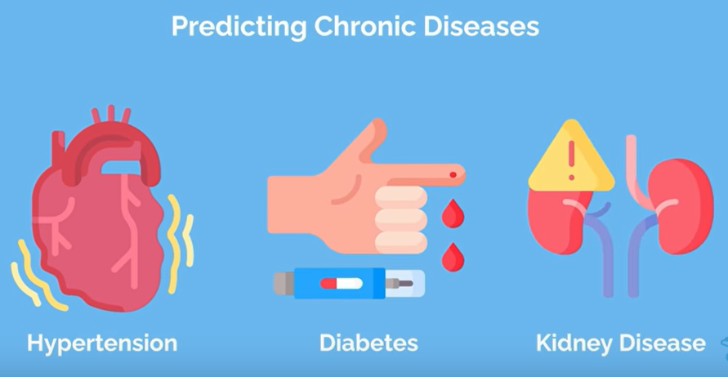

Slide 8
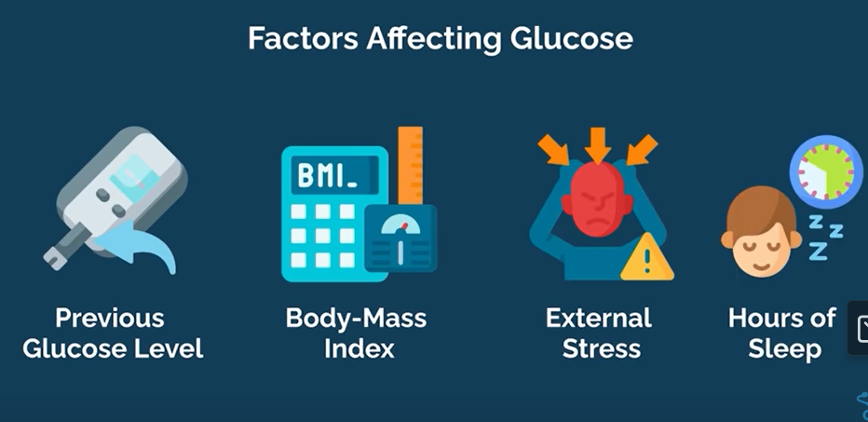
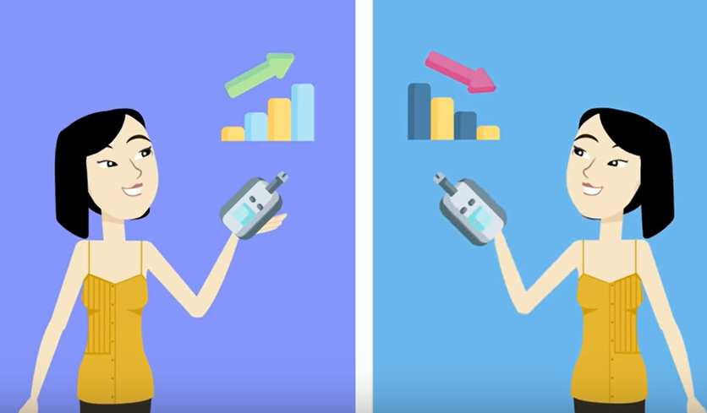
Estimate current Glucose level
Labelling high or low glucose --- Better prepare patient for emergency
Give recommendation also in order to prevent the likelihood of dieses

Slide 9
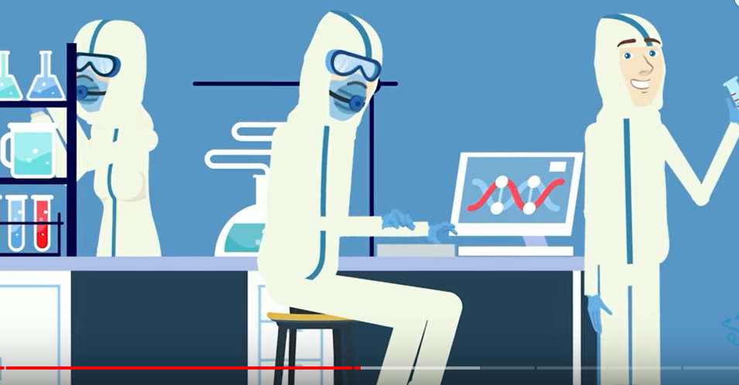
3. Research

Slide 10
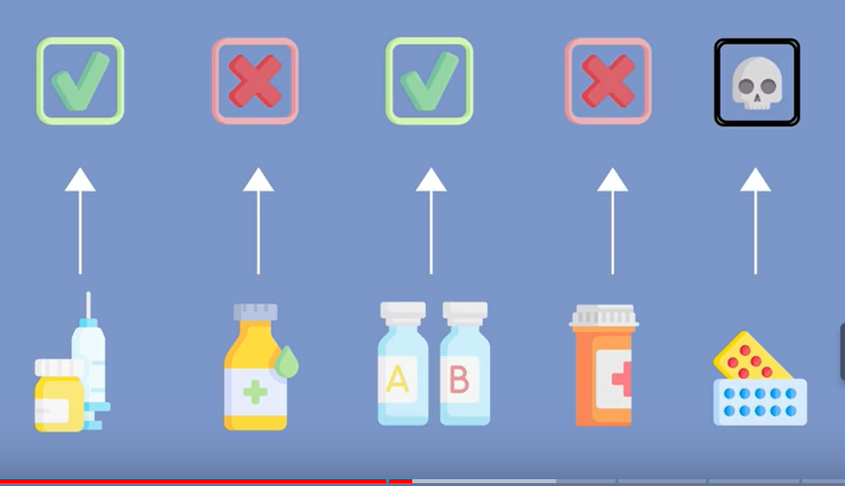
Clinical Trials using AI to determine new vaccine and medicine

Slide 11
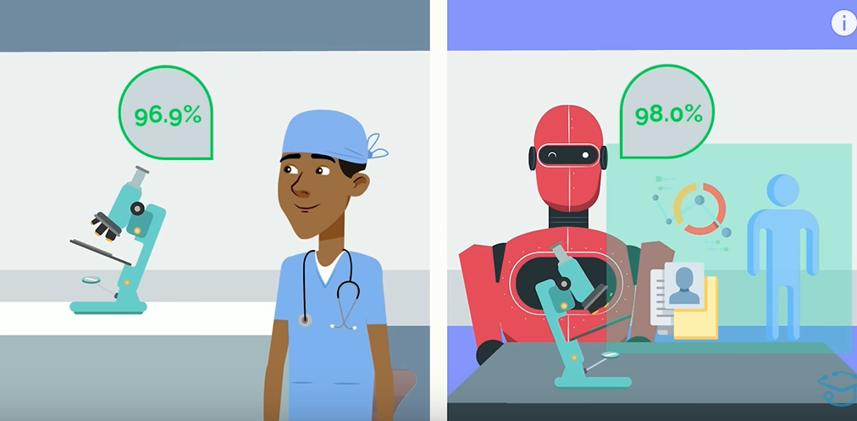
Cancer dieses prediction comparison

Slide 12

3. Telemedicine
Allow patients to receive a level of treatment similar to going to a hospital, without leaving their home

Slide 13
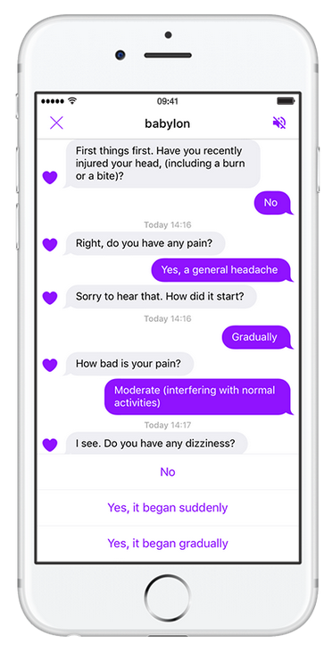
Companies like Babylon Health, have developed AI Chatbots able to provide medical guidance to patients.
.

Slide 14
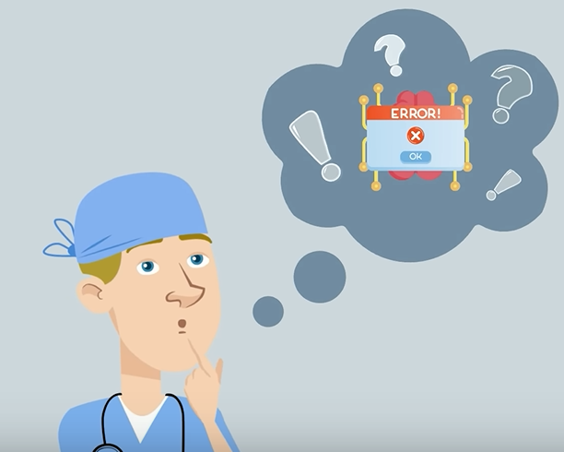
Limitations of AI

Slide 15
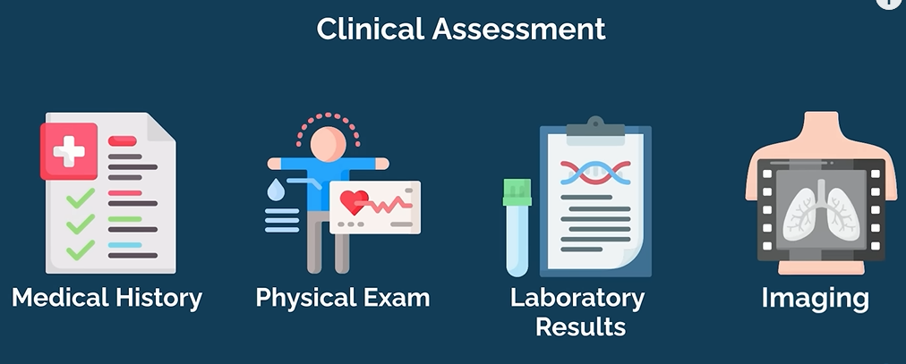

Slide 16
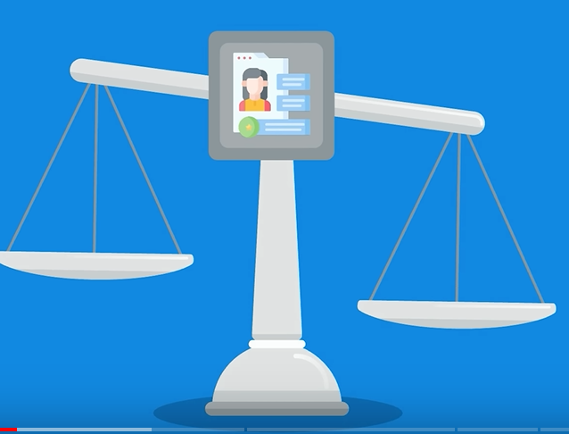
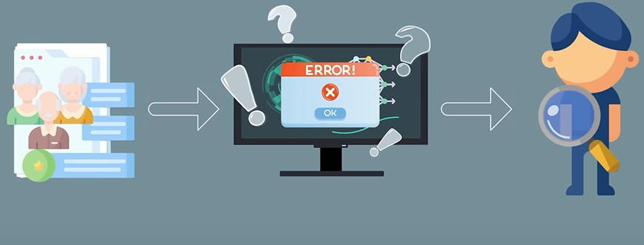
Biases in dataset

Slide 17
